Slide 1
Predicting Loan Repayment
Spring Board Data Science Project
March 2022

Slide 2
The Problem
Lending club, the fin tech market place bank, headquartered in San Francisco, California
The company has to make a decision on loan application for loan approval based on the applicant’s profile
How can lending club make decisions on issuing loans, so that the risk can be lowered, and the profit can be maximized?

Slide 3
Who might care?
The lending club management
Customers
Members

Slide 4
What factors might affect loan repayment?
Annual income
Employment ,Home Ownership
FICO Score
Purpose, Grade, interest rates
DTI
Data Source-Lending Club database

Slide 5
Data information
Initial dataset:1048576 rows and 136 columns
Included only loans for which status is either fully paid or default
Final dataset:482616 rows and 104 columns

Slide 6
Data Wrangling
Removed all columns which are theoretically not supposed to have a relationship with loan status and also which has more than 80 percent missing values
No duplicate values
Outlier detection and removal
Conversion of non numerical to numerical variables

Slide 7
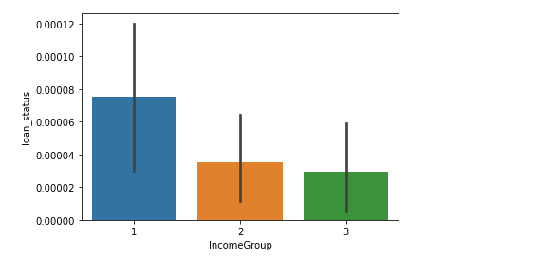
Feature Engineering and Exploratory Data Analysis
Income group a new feature by regrouping income into categories
Income group having significant association with loan status
Similarly ,visualization plots show association between fico range, purpose, grade and homeownership variables with loan status
No correlation between loan status variable and the numerical variables

Slide 8
Modeling
Target variable=Loan Status(“0” as fully paid and “1” as default )
6 features in the final model
Random Forest, Logistic Regression and Decision Tree Classifiers
Precision, recall and f1 score are all zero with all the three classifiers since the data is highly unbalanced.
Data balance using SMOTE

Slide 9
Model Comparison
Evaluation Metrics(Final Models)
Final model-Logistic Regression Model
The logistic regression can classify 75% of the applicants that will default when compared with 25 percent of default by random forest and decision tree after re sampling

Slide 10
Conclusion and Future Research
Most important features- purpose of loan, home ownership, grade, income category and fico score
dti, employment length, revolving balance, hardship status etc not included in the final model based on preliminary analyses
Able to identify those loans that are likely to have chances for default, based on the model
Possibility of including boosting models and SVM for improving model performance
To find the optimized threshold for the models, the maximum profit needs to be located based on the revenue and cost

